Slide 1

Operating Systems Lab

Slide 2
Monitors
Lab Instructor: Aliza Saeed
(FAST-NU CFD Campus).
Email: aliza.saeed@nu.edu.pk

Slide 3
A monitor is a programming language construct that controls access to shared data
A monitor is a module that encapsulates
  Shared data structures
  Procedures that operate on the shared data structures
  Synchronization between concurrent procedure invocations
A monitor protects its data from unstructured access
It guarantees that threads accessing its data through its procedures interact only in legitimate ways

Slide 4
Monitors
A class providing both synchronization and notification.
The Monitor class is based on the concept of a Mutex and a Conditional Variable.
Mutex is used to synchronize access to a shared object.
Condition Variable is used to wake up waiting threads when the shared object has changed.
Monitor can also be considered as a class whose data members are private and whose member functions are implicitly executed with mutual exclusion.
Monitors can be included in a language (Mesa, Java) but in C++, they are just a programming pattern that involves a structured way of using mutex and condition variables.

Slide 5
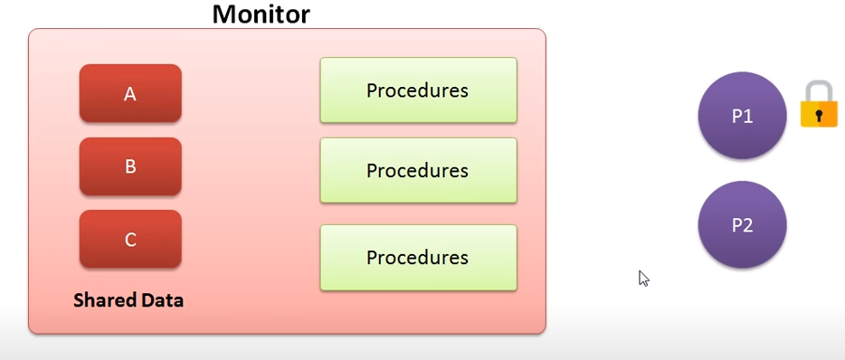

Slide 6
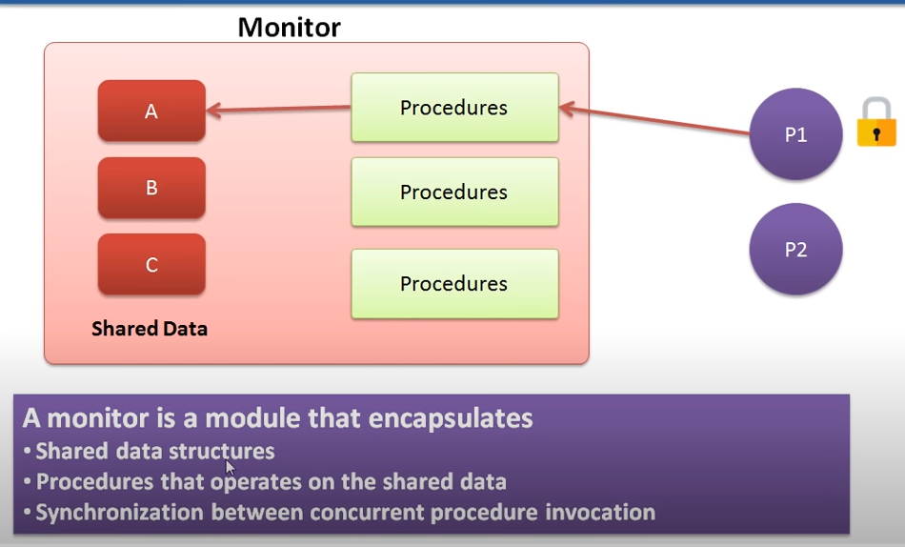

Slide 7
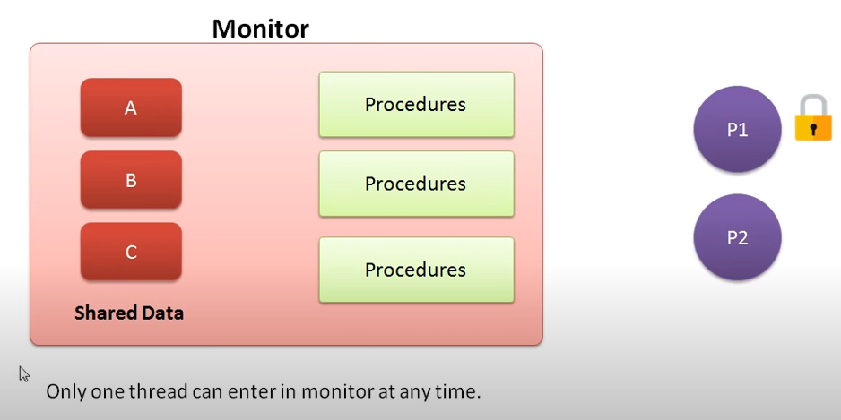

Slide 8
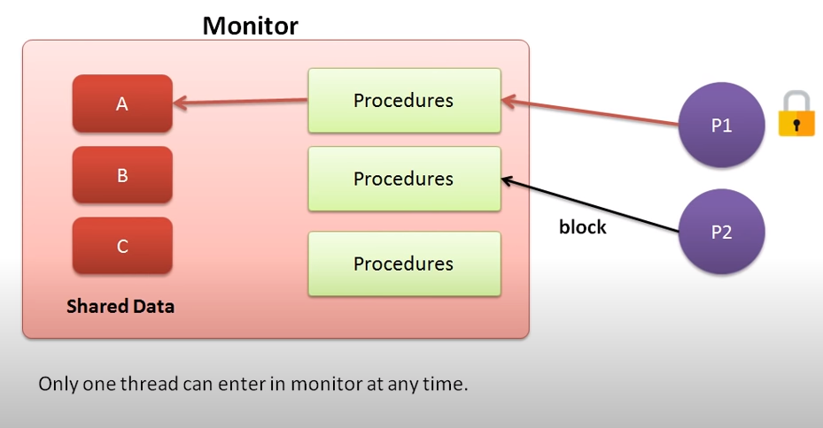

Slide 9
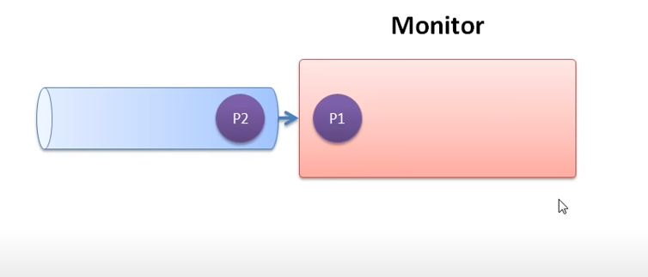

Slide 10
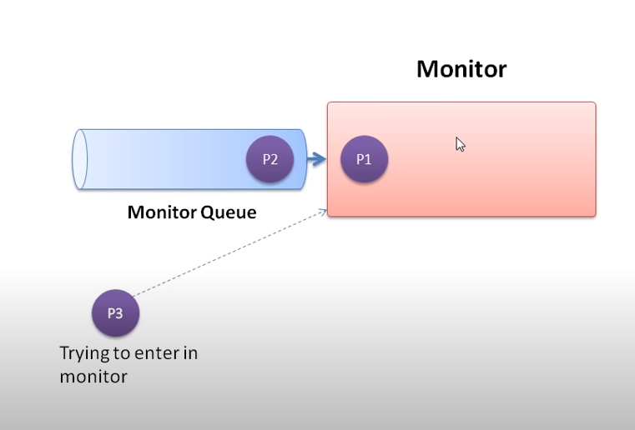

Slide 11
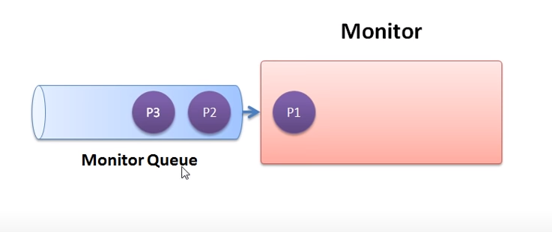

Slide 12
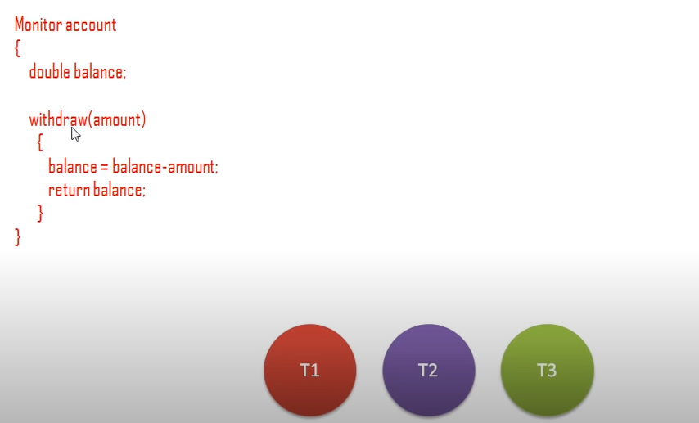

Slide 13
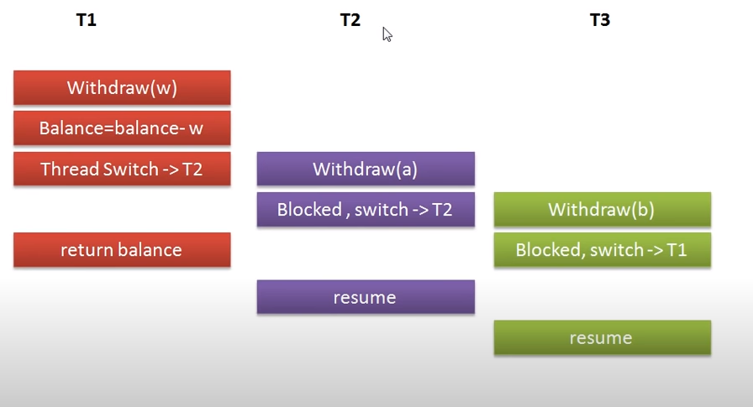

Slide 14
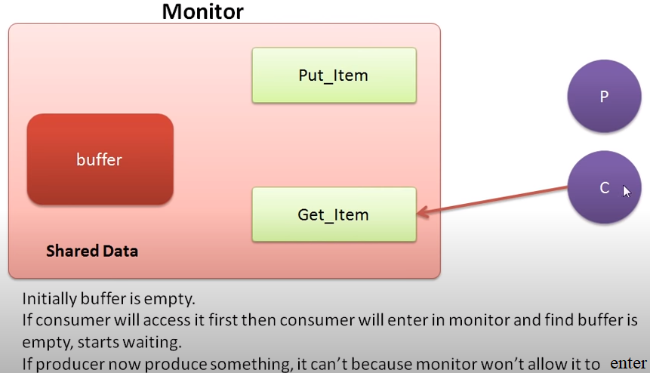

Slide 15
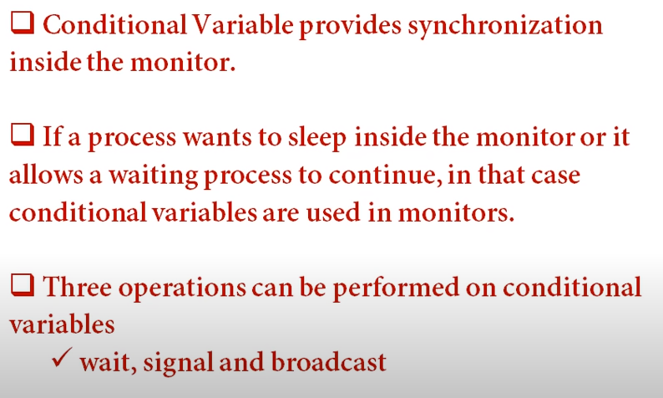

Slide 16
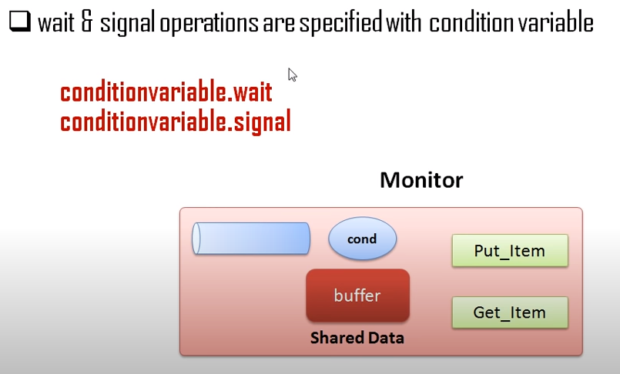

Slide 17
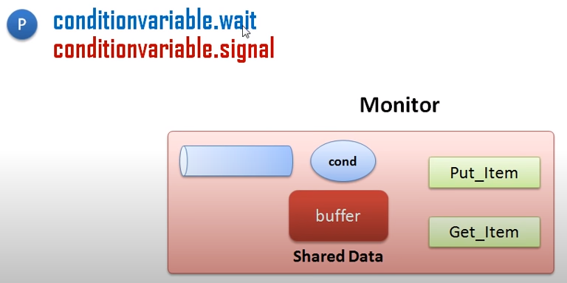
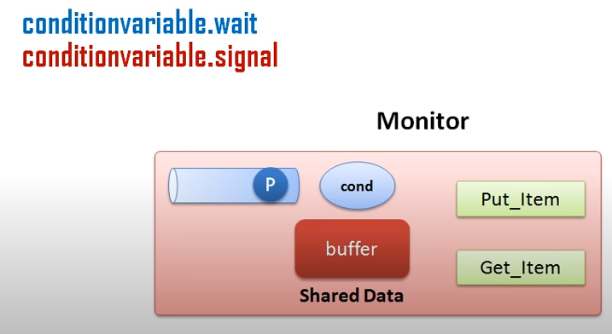

Slide 18
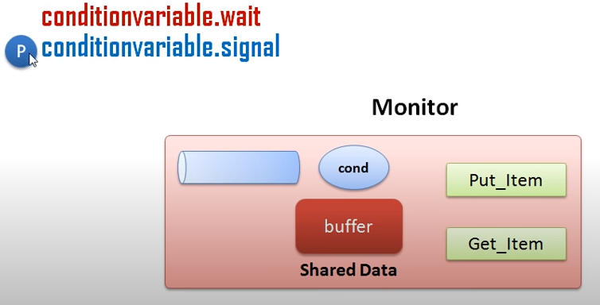

Slide 19
Rules to Follow with Monitors
Any process can call a monitor procedure at any time
But only one process can be inside a monitor at any time (mutual exclusion)
No process can directly access a monitor‟s local variables (data encapsulation)

Slide 20
Monitors in C++
POSIX Threads
No compiler support, must do it manually
Must declare locks & condition vars
Must call lock_acquire/lock_release when entering&leaving the monitor
Must use cond_wait/cond_signal to wait for/signal condition
Note: cond_wait(&c, &m) takes monitor lock as parameter
Necessary so monitor can be left & re-entered without losing signals

Slide 21
Example (Monitors)
Problem Statement:
Class BankAccount
  Use monitor as a bank account i.e. Threads withdraws and deposit money
deposit()
  Deposit money as long as the balance<500.
  If balance >=500 signal the withdraw function that is waiting.
Withdraw()
  Waiting for a signal from the deposit() (balance >=500), withdraw the amount and signal back
  If amount to be withdrawn is greater than balance quit the program

Slide 22
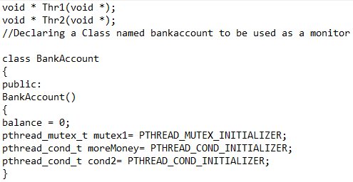
Example (Monitors)
(Class and Constructor)

Slide 23
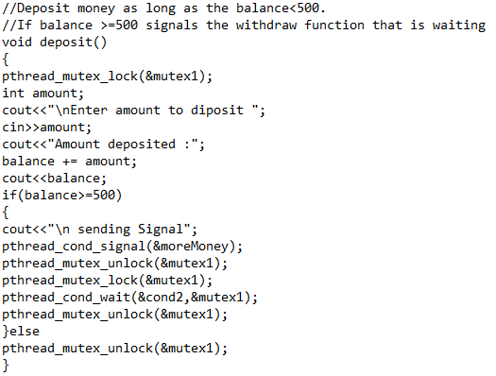
Example (Monitors)
(deposit)

Slide 24
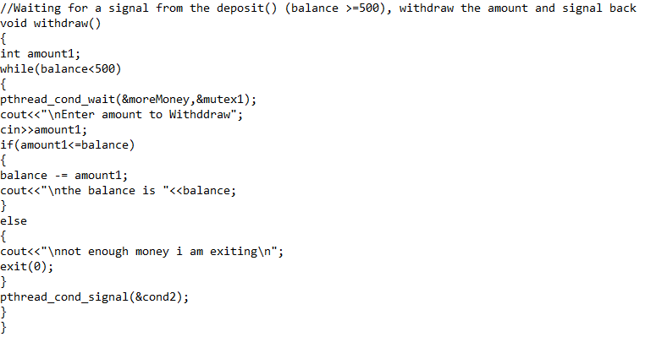
Example (Monitors)
(withdraw)

Slide 25
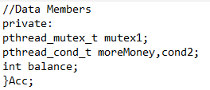
Example (Monitors)
(Data Members of BankAccount)

Slide 26
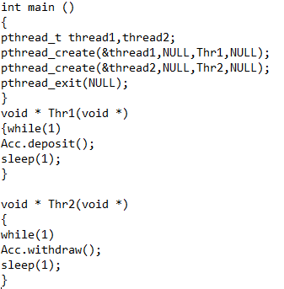
Example (Monitors)
(main() and thread functions)

Slide 27
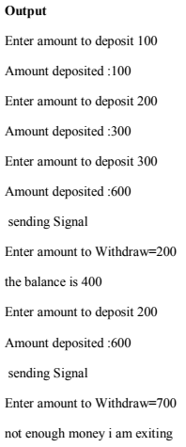
Example (Monitors)
(Output)

